Slide 1
PREDICTIVE MODELING USING MACHINE LEARNING
MANAGEMENT OF EMPLOYEE ABSENTEEISM
PROJECT PART-1,PART-2
MENTOR: MUNNA PANDEY
SUBMITTED BY: M.PRIYANKA

Slide 2
OBJECTIVE OF PROJECT
This project focuses on analyzing data about employee absenteeism.
The goal is to help companies understand why employees miss work, identify patterns, and predict future absences.
This will help businesses manage their workforce better, improve productivity, and create a positive work environment.
And also the goal of this project is to extract valuable information from the employee absenteeism dataset.

Slide 3
DATA CLEANING:
Perform necessary data cleaning steps to convert messy , unclean data into clean data.
CODE:
df.isnull().sum() #Finding missing values
df.dtypes #Finding datatype
#Checking outlier if any
def outliers(df):
for col in df.select_dtypes(include=['number']).columns: q1=df[col].quantile(0.25)
q3=df[col].quantile(0.75)
IQR=q3-q1
LF=q1-1.5*IQR
UF=q3+1.5*IQR

Slide 4
outlier=df[(df[col]<LF) | (df[col]>UF)]
return outlier
# call
alloutlier=outliers(df)
alloutlier
# Removed outliers for all the columns:
def remove_outliers(df):
for col in df.select_dtypes(include=['number']).columns: q1=df[col].quantile(0.25)
q3=df[col].quantile(0.75)
IQR=q3-q1
LF=q1-1.5*IQR
UF=q3+1.5*IQR

Slide 5
outlier_removal=df[(df[col]<=LF) & (df[col]>=UF)]
return outlier_removal
alloutlier=remove_outliers(df)
df
#Finding duplicates if any then dropping duplicates
df1=df.drop_duplicates()
df1
INTERPRETATION: To clean the data so we need to follow some steps. They are missing value treatment and outlier treatment and duplicates removing
So from this, applied above those steps and perfomed the cleaning process

Slide 6
UNDERSTANDING ABSENTEEISM PATTERNS
How does absenteeism vary across different employee demographic (age , education level , son , reason for absence etc..)and work characteristics(disciplinary failure , hit target etc..)
Perform descriptive analysis to find answer to the above question.
CODE:
Absenteeism by Age
age_group_absenteeism = df1.groupby('Age')['Absenteeism time in hours'].mean().reset_index()
# Plot absenteeism by Age
plt.figure(figsize=(10, 6))
plt.plot(age_group_absenteeism['Age'], age_group_absenteeism['Absenteeism time in hours'], marker='o’)
plt.title('Absenteeism by Age')

Slide 7
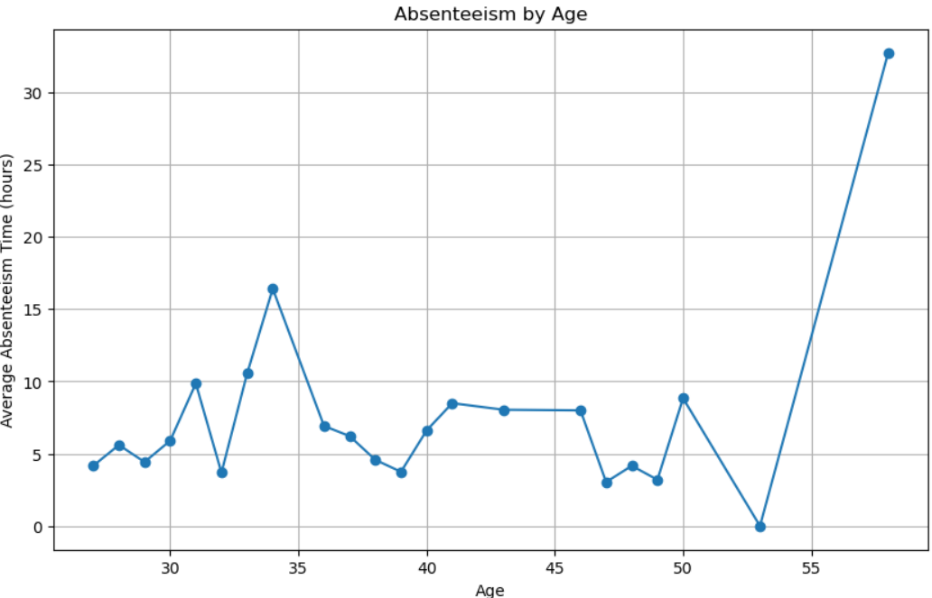
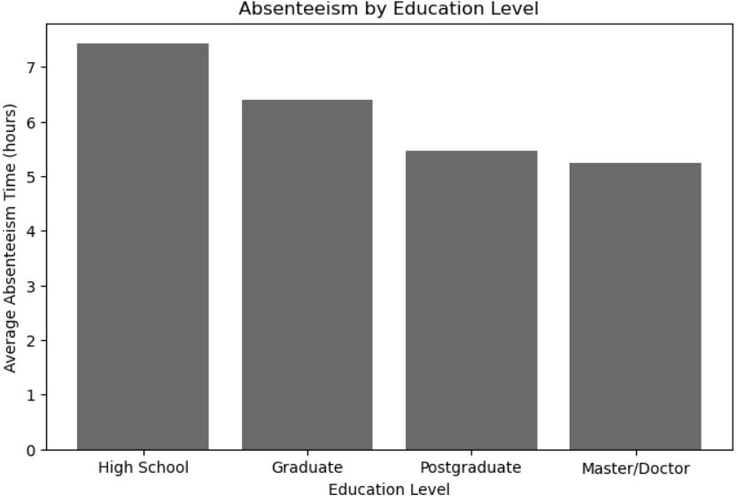
plt.xlabel('Age’)
plt.ylabel('Average Absenteeism Time (hours)’)
plt.grid(True)plt.show()
Absenteeism by Education
education_group_absenteeism =
df1.groupby('Education’)
['Absenteeism time in hours'].mean().reset_index()
# Bar plot for absenteeism by Education
plt.figure(figsize=(8, 5))
plt.bar(education_group_absenteeism
['Education'], education_group_absenteeism
['Absenteeism time in hours’])

Slide 8
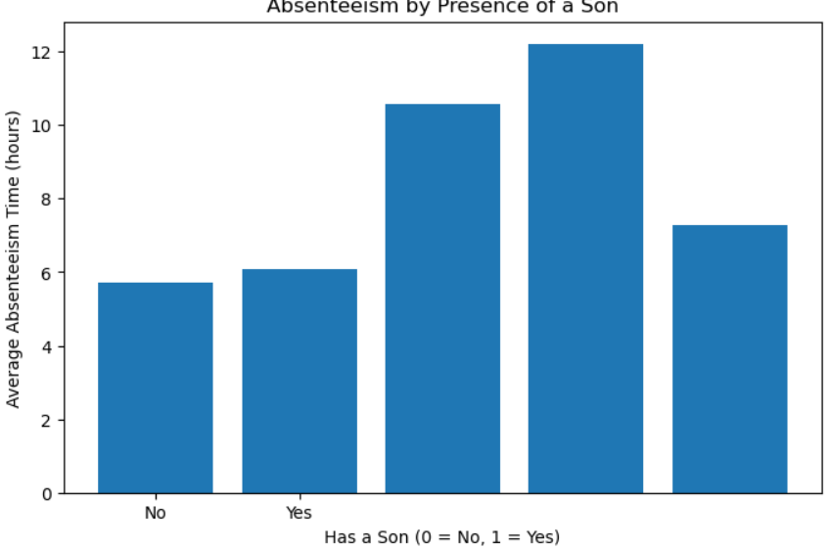
plt.title('Absenteeism by Education Level’)
plt.xlabel('Education Level’)
plt.ylabel('Average Absenteeism Time (hours)’)
plt.xticks([1, 2, 3, 4], ['High School', 'Graduate', 'Postgraduate', 'Master/Doctor’])
plt.show()
Absenteeism by Son (Has a Son vs No Son)
son_group_absenteeism = df1.groupby('Son')['Absenteeism time in hours'].mean().reset_index
plt.figure(figsize=(8, 5))
plt.bar(son_group_absenteeism['Son’],
son_group_absenteeism['Absenteeism time in hours’])
plt.title('Absenteeism by Presence of a Son’)
plt.xlabel('Has a Son (0 = No, 1 = Yes)’)
plt.ylabel('Average Absenteeism Time (hours)')

Slide 9
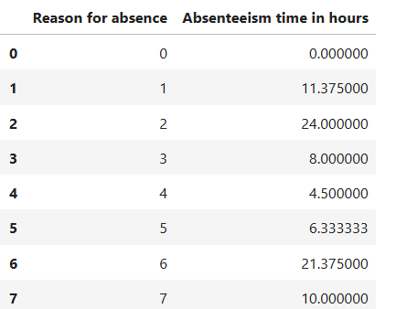
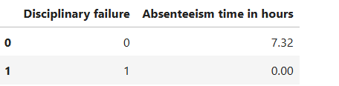
Absenteeism by Reason for Absence
reason_group_absenteeism = df1.groupby('Reason for absence')['Absenteeism time in hours'].mean().reset_index()
Absenteeism by Disciplinary Failure
disciplinary_group_absenteeism = df.groupby
(Disciplinary failure')['Absenteeism time in hours'].mean().reset_index()
INTERPRETATION: From this identified the absenteeism
by age and absenteeism by son and reason for absence and
Absenteeism by disciplinary failure.

Slide 10

ANALYZING REASONS FOR ABSENTEEISM
What are the most frequent reasons for employee absence ?Are there are any patten in these reason.
CODE:
df2=df1['Reason for absence'].value_counts(normalize=True).
sort_values(ascending=True).mode()
df2
df2.plot(x=df2.index, y=df2.values,kind='barh’)
plt.title('Most Frequent Reasons for Employee Absenteeism’)
plt.xlabel('Reason for Absence’)
plt.ylabel('Frequency’)
plt.xticks(rotation=90)
plt.show()

Slide 11
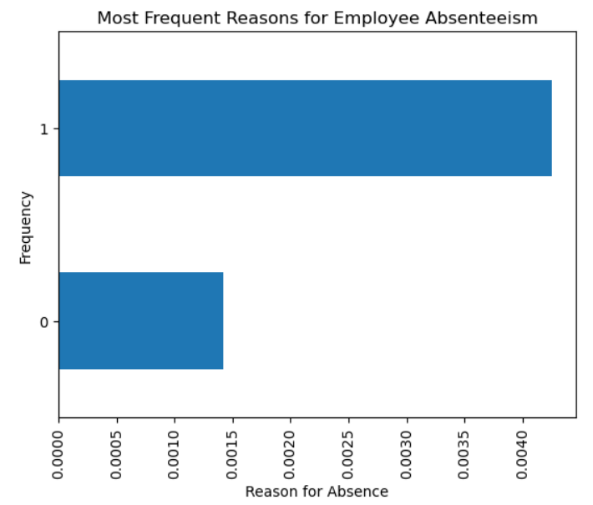
plt.xticks(rotation=90)
plt.show()
print("Unique Reasons for Absence:\n", df1['Reason for absence'].value_counts(normalize=True).unique())
INTERPRETATION: From this identified the most frequent reason for the absence.

Slide 12
PREDICTING ABSENTEEISM DURATION
Can we predict the duration of an employee's absence based on factors like reason for absence, disciplinary failure, distance from residence to work, obesity, etc.?
Perform predictive analysis to forecast the duration of an employee's absence based on various factors mentioned above
CODE:
features = ['Reason for absence', 'Disciplinary failure', 'Distance from Residence to Work', 'Body mass index', 'Transportation expense', 'Age', 'Work load Average/day ‘]
target = 'Absenteeism time in hours’
X = df1[features]y = df1[target]
scaler = StandardScaler()
x = scaler.fit_transform(X)
X_train, X_test, y_train, y_test = train_test_split(x, y, test_size=0.3, random_state=42)
model = LinearRegression()

Slide 13
model.fit(X_train, y_train)
y_pred = model.predict(X_test)
mae = mean_absolute_error(y_test, y_pred)mse = mean_squared_error(y_test, y_pred)
rmse = np.sqrt(mse)
r2 = r2_score(y_test, y_pred)
print("\nModel Performance Metrics:")print(f"Mean Absolute Error (MAE): {mae:.2f}")print(f"Mean Squared Error (MSE): {mse:.2f}")print(f"Root Mean Squared Error (RMSE): {rmse:.2f}")print(f"R-squared (R²): {r2:.2f}")
feature_importance = pd.DataFrame({'Feature': features, 'Coefficient': model.coef_})print("\nFeature Importance:")
print(feature_importance.sort_values(by='Coefficient', ascending=False)
intercept = model.intercept_slope = model.coef_[0]
print(f"Intercept: {intercept}")print(f"Slope: {slope}")

Slide 14
IDENTIFYING EMPLOYEE AT RISK OF ABSENTEEISM
Can we identify employees who are more likely to have high absenteeism using factors like demographics, work characteristics, and past absence data?
Build Logistic Regression and KNN models to classify employees who are more likely to have high absenteeism using factors like demographics, work characteristics, and past absence data. Further compare them to choose the best classifier model to identify employees who likely to have high absenteeism.
CODE:
features = ['Reason for absence', 'Disciplinary failure', 'Age', 'Distance from Residence to Work', 'Body mass index', 'Transportation expense', 'Work load Average/day ‘]
target = 'Absenteeism time in hours’
X = df[features] ,y = df[target]
scaler = StandardScaler()
X_scaled = scaler.fit_transform(X)
X_train, X_test, y_train, y_test = train_test_split(X_scaled, y, test_size=0.3, random_state=42)
logreg = LogisticRegression() ,logreg.fit(X_train, y_train)

Slide 15
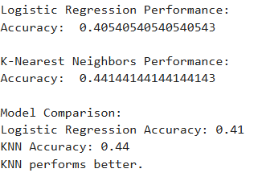
logreg_pred = logreg.predict(X_test)
print("Logistic Regression Performance:")
print("Accuracy: ", accuracy_score(y_test, logreg_pred))
knn = KNeighborsClassifier() OUTPUT
knn.fit(X_train, y_train)
knn_pred = knn.predict(X_test)
print("\nK-Nearest Neighbors Performance:")
print("Accuracy: ", accuracy_score(y_test, knn_pred))
ogreg_acc = accuracy_score(y_test, logreg_pred)
knn_acc = accuracy_score(y_test, knn_pred)
print("\nModel Comparison:")
print(f"Logistic Regression Accuracy: {logreg_acc:.2f}")
print(f"KNN Accuracy: {knn_acc:.2f}")
if logreg_acc > knn_acc:
print("Logistic Regression performs better.")else: print("KNN performs better.")

Slide 16
CONCLUSION:
In the part 1 performed the data cleaning steps .
And also determined the absenteeism vary across different employee demographic like age and son and reason for absence and etc..
And from the education the absenteeism has highest in high school compared to the others, and in the age 53 above the absenteeism has highest.
And also determined the absenteeism duration of employee absence.
In part 2 also performed data cleaning steps to get the cleaned the data.
And identified the employee risk at absenteeism with the help of logistic regression and KNN and identified that KNN performance is better than logistic regression.

